Slide 1

Lending Club Case Study
By
Manivannan K
Vinu Priya D

Slide 2
Background – Lending Club Case Study
Background
The background of the project involves peer-to-peer lending, where borrowers can obtain loans and investors can fund those loans.
Business Objective
The business problem being addressed is identifying factors that contribute to loan defaults and assessing the risk associated with different types of loans.
The dataset used includes information on loan amounts, interest rates, borrower details, loan status, etc.

Slide 3
Univariant Analysis

Slide 4
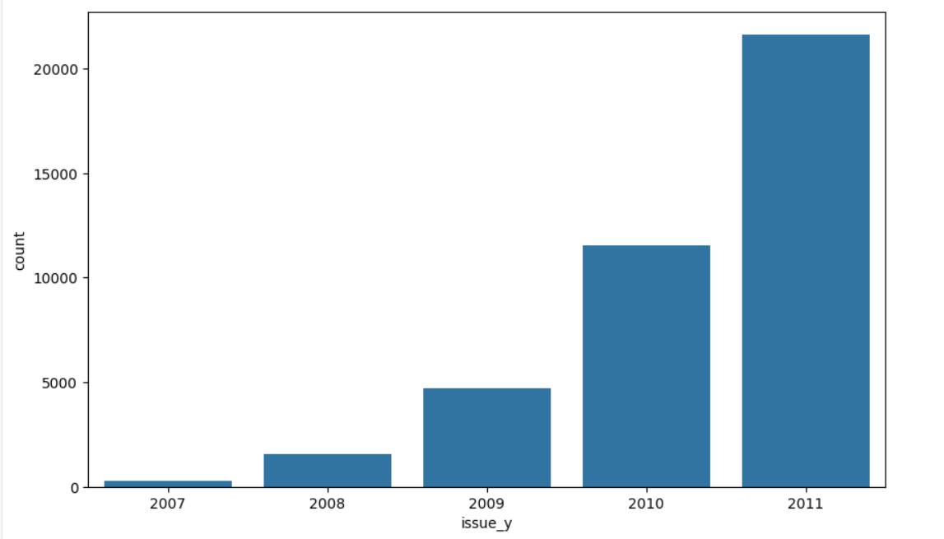
Time Frame of the Data – 2007 to 2011
Time Frame Bar chart provides us the information on the increasing growth of lenders every year.
We could see an exponential growth of 40% every year which is good sign.
To know more about the potential defaulters list we will analyse loan amounts, interest rates, borrower details, loan status, etc.

Slide 5
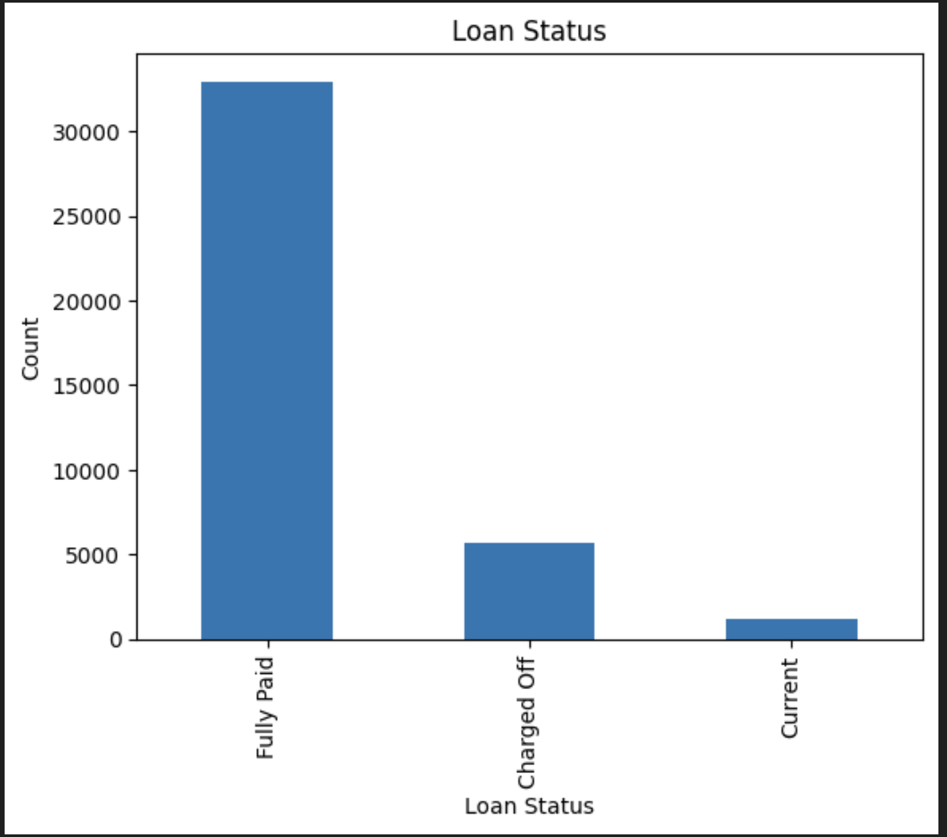
Loan Status
Analysing the loan status we could see the majority of loans are successfully paid off, which is a positive indicator of borrower reliability.
There is a significant number of charged-off loans, which may indicate some risk in lending practices.
As per the Business objective to identify the risk factors in the lending practices we have considered Loan Status , charged of as the target variable

Slide 6
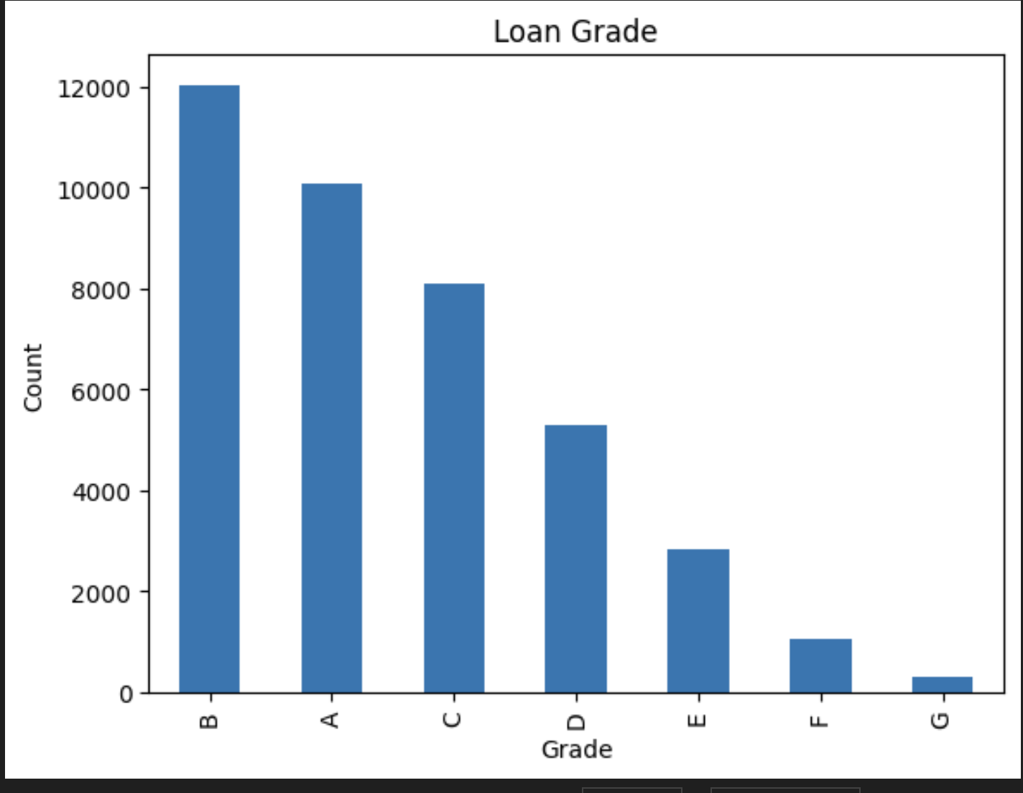
Loan Grade Assigned by LC
Analysing the bar chart we could see Grade B has the highest count of borrowers and Grade G has got the minimum number of count.
Though we don’t have the extract data on how these grade are provided we have the data on the sub-grades .
We have tried comparing the the loan amount with the combination of Grade and sub- grades to get more clarifications

Slide 7
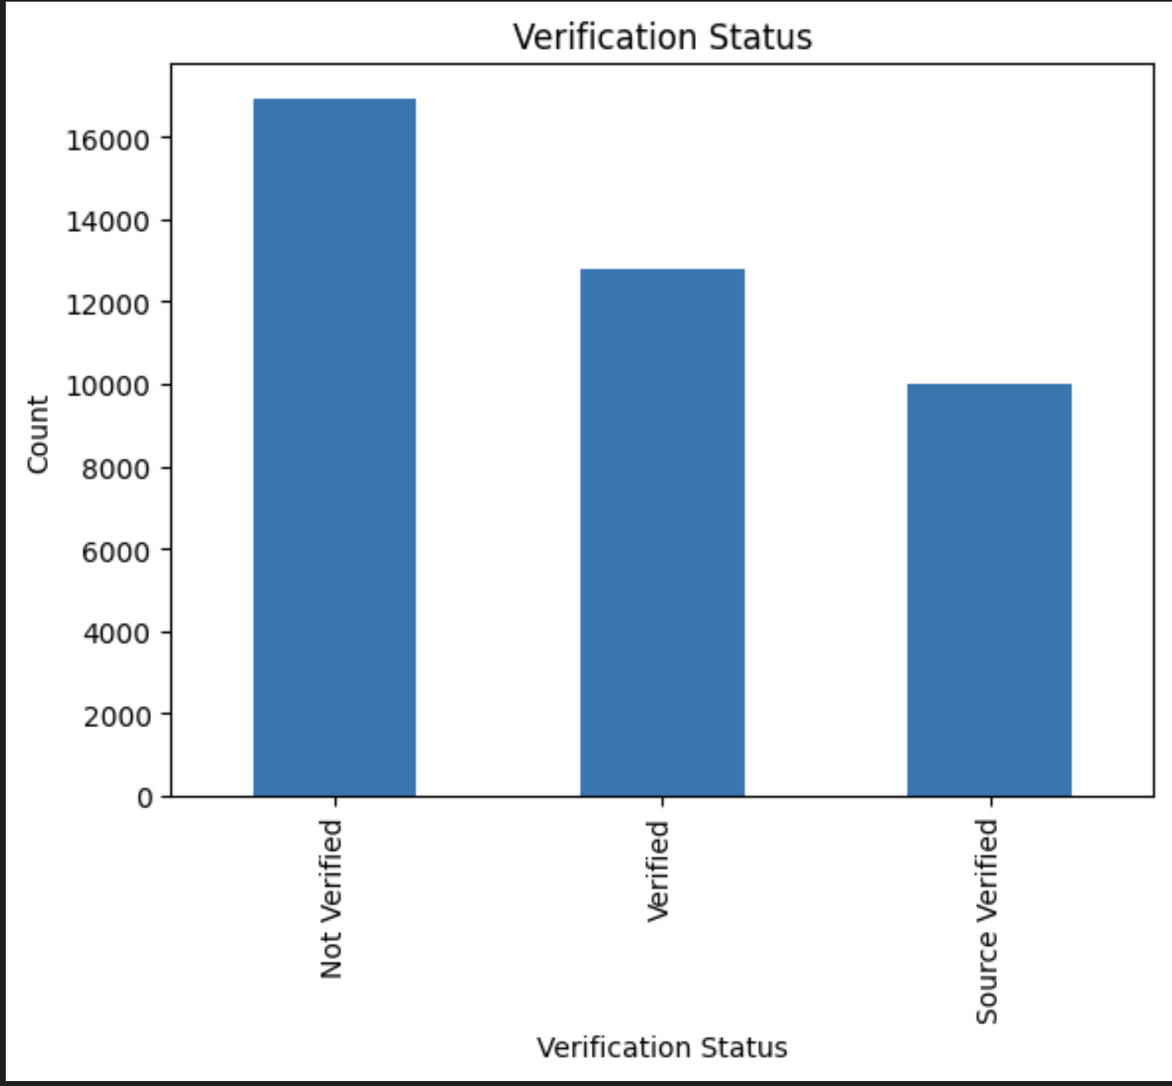
Verification Status of the Borrower
Overall, the majority of the data remains unverified, with a significant portion verified, and a smaller portion verified using a specific source. This indicates that while some data has undergone verification, there is a considerable amount that has not yet been validated.

Slide 8
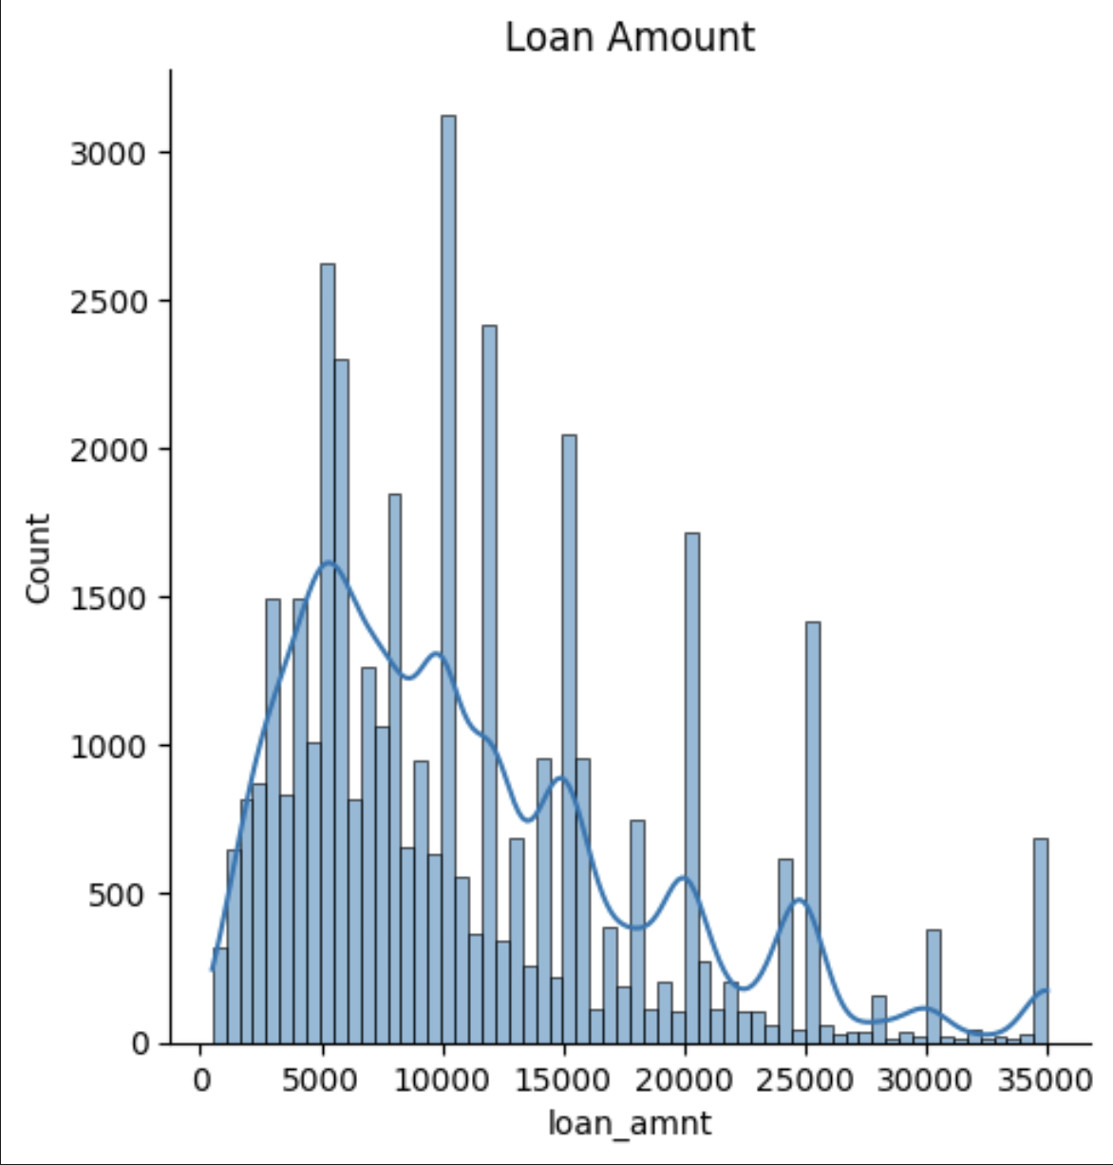
Loan Amount and Frequency
The majority of loan amounts is between 5,000 and 15,000, with a noticeable peak around 10,000 to 12,000. This suggests that these are the most frequently requested loan amounts.
The highest frequency of loans, with counts exceeding 2,500, is observed in the 10,000 to 12,000 range.
Overall, the data shows that lower to mid-range loan amounts are more common, with a gradual decrease in frequency as loan amounts increase.

Slide 9
Bivariant Analysis

Slide 10
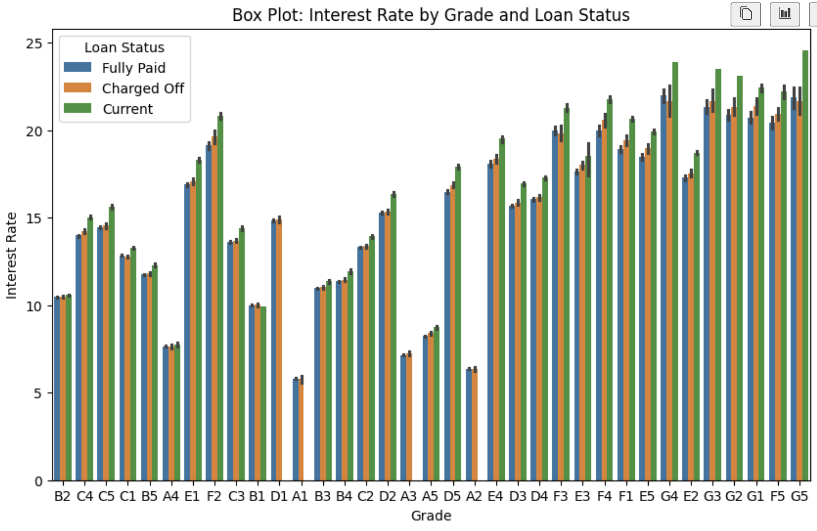
Loan Amount Vs Grades
From the distribution of interest rates, we could see it’s apparent that the median interest rates vary across different loan grades and statuses.
The box plot indicates the spread of interest rates within each grade and loan status category, providing insight into the variability and central tendency of interest rates.

Slide 11
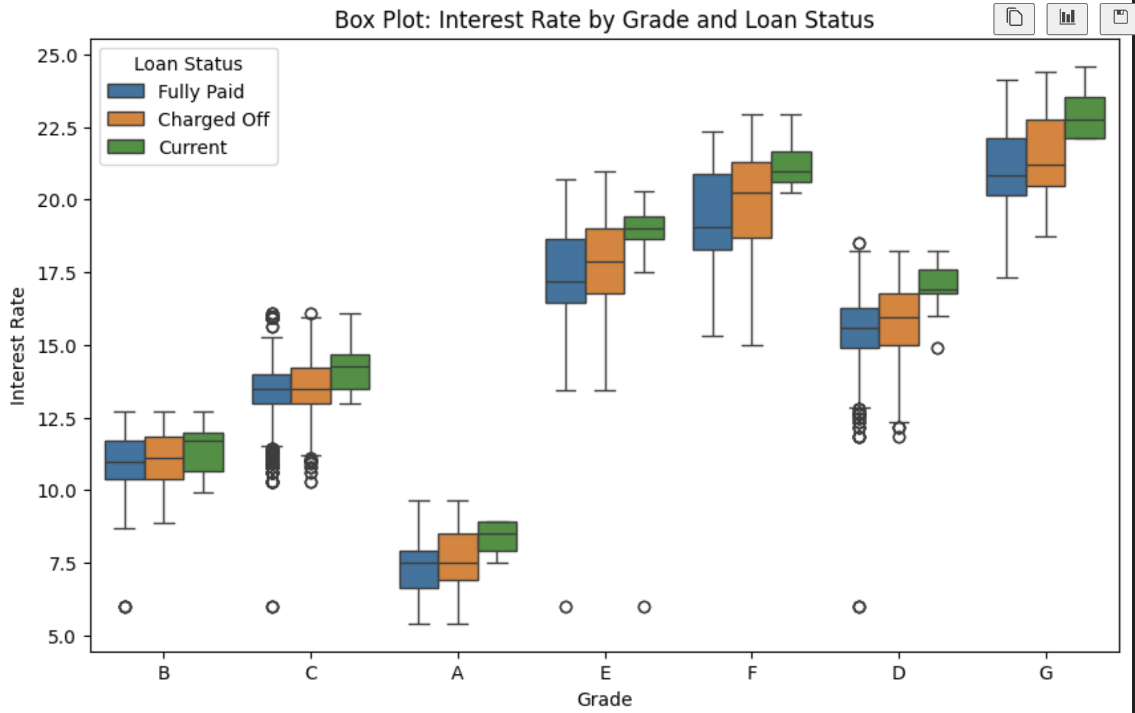
Box Plot: Distribution of interest rates across different grades
From the distribution of interest rates, and grade shown as E, F and G are paying more interest rates

Slide 12
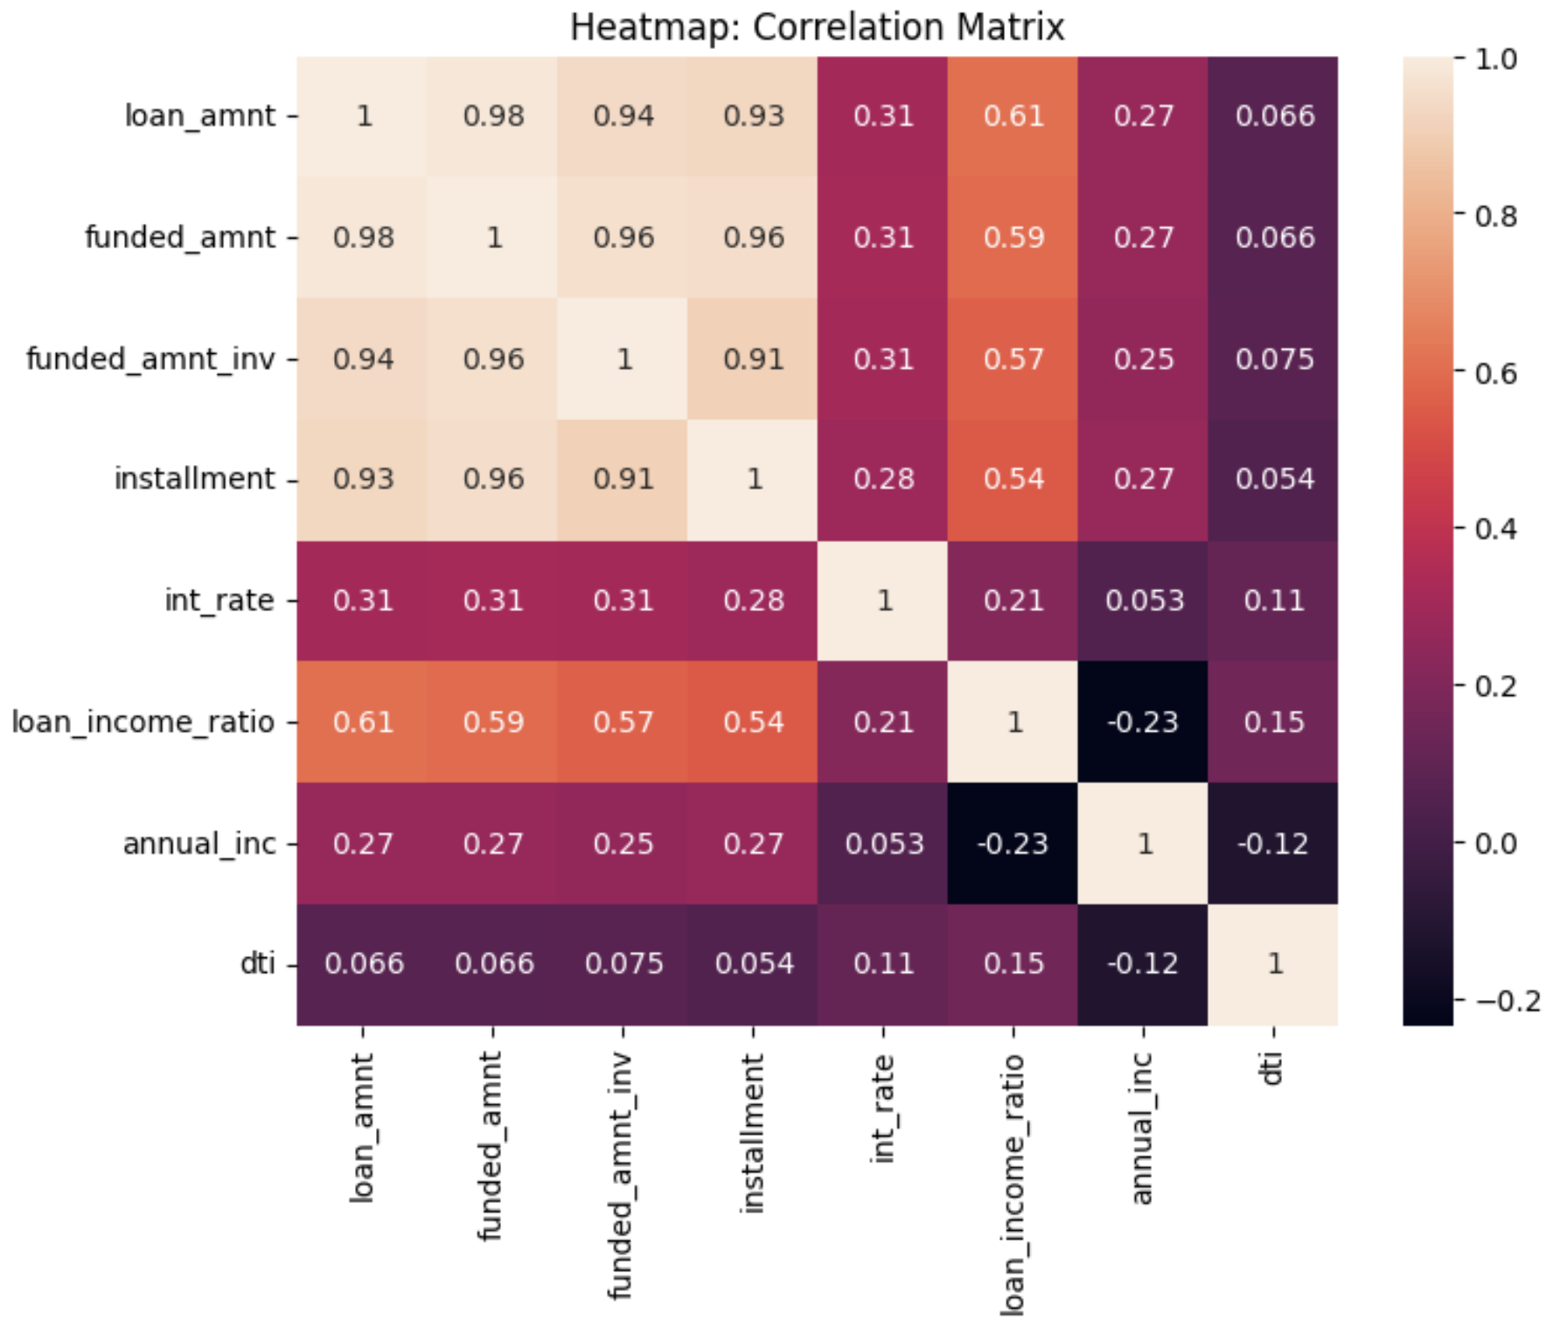
HeatMap: All continuos variables Insights
It is clear from the Heatmap that how 'loan_amnt','funded_amnt' & 'funded_amnt_inv' are closely interrelated. So we can take any one column out of them for our analysis.

Slide 13
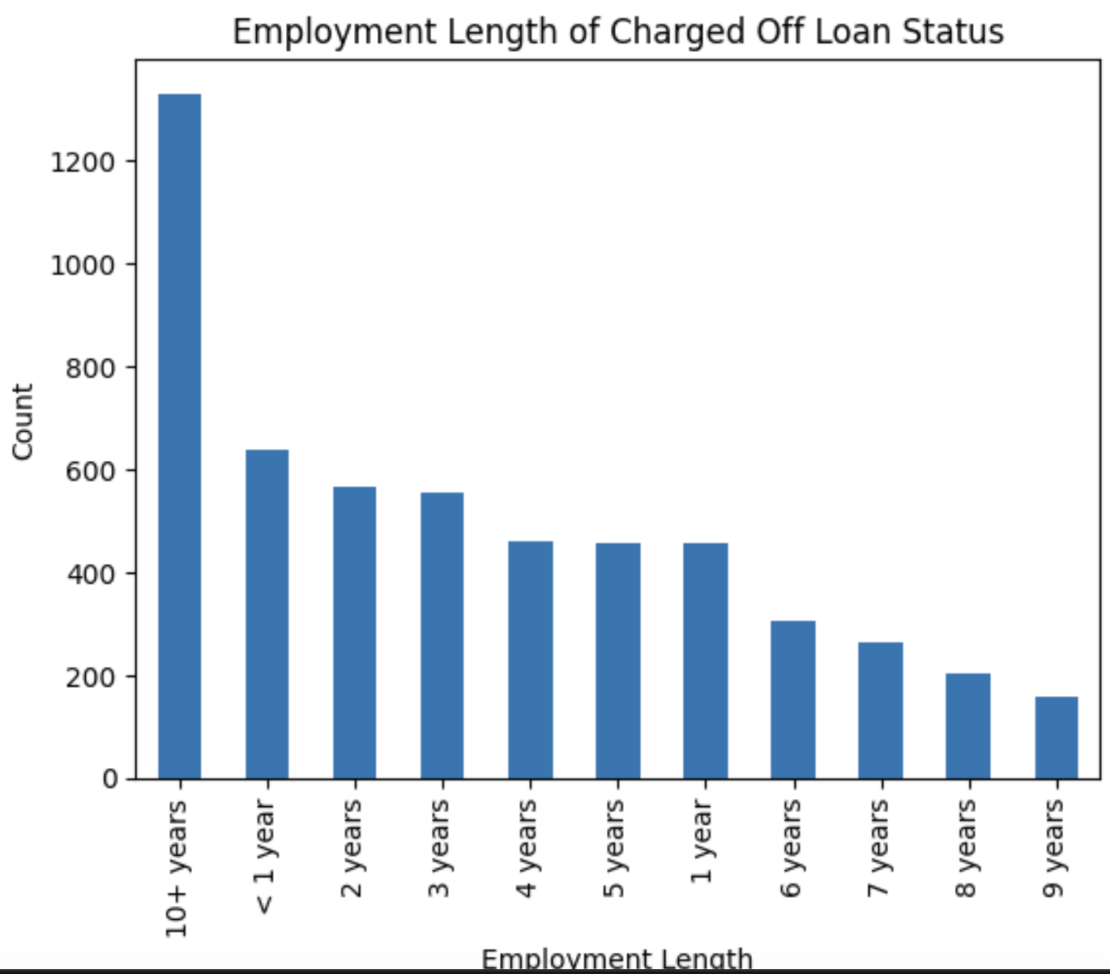
Employment Length of Charged Off Loan Status
Applicants less than 1 year of experience or more than 10 years experience probable of charged off

Slide 14
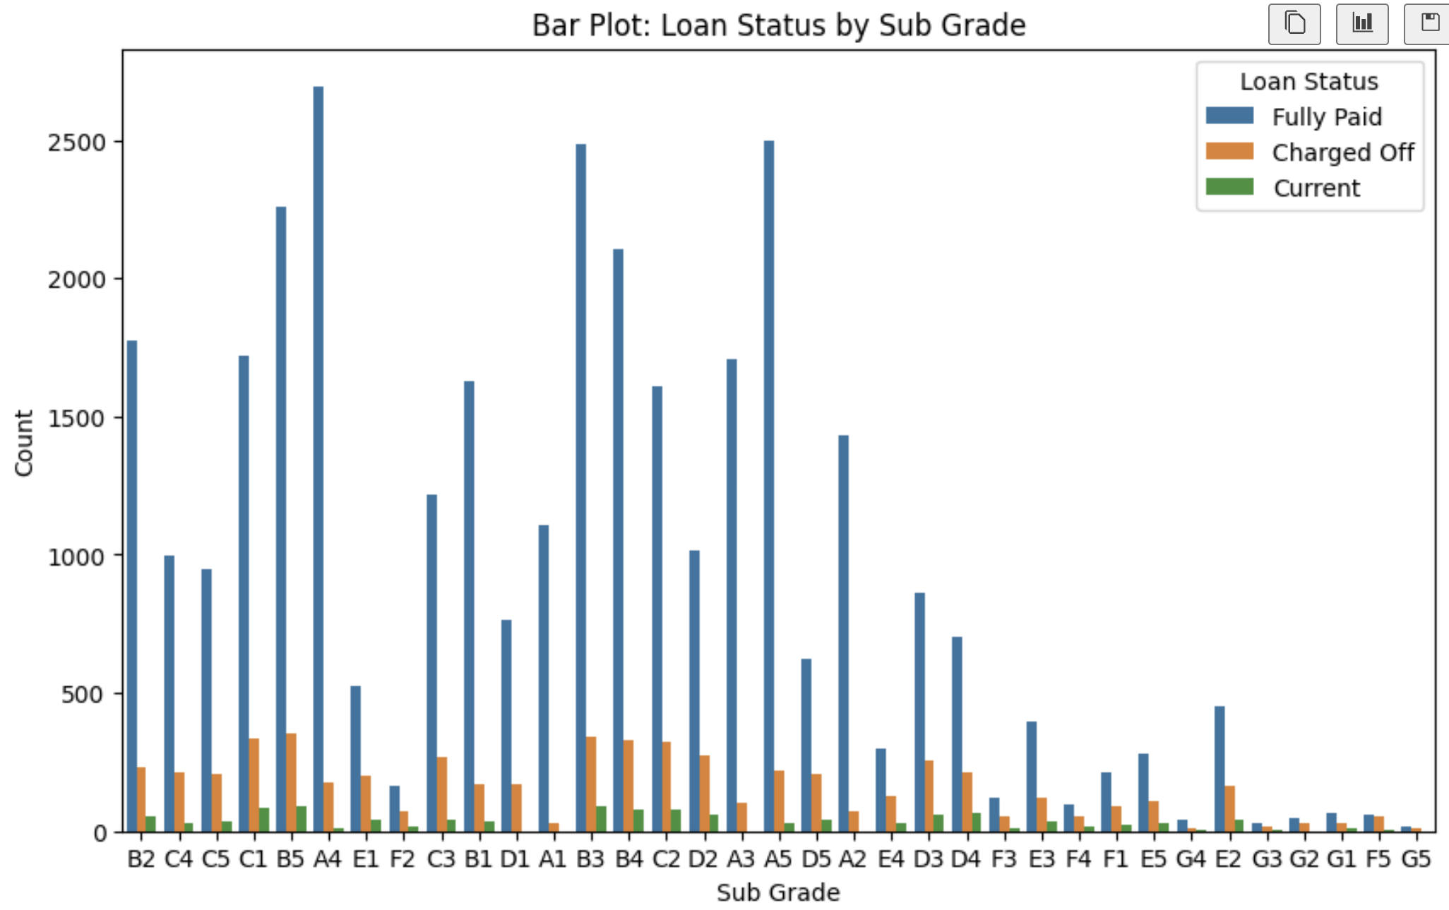
Bar Plot: Count of loan statuses by grade
The Bar Plot shows for Sub Grade by
Loan status that the B5, A5 and A4 are good at paying loan

Slide 15
Outcome of EDA
Borrower credit scores are a significant factor in loan performance.
Higher interest rates are associated with higher default rates.
Income levels of borrowers impact their ability to repay loans.
Certain loan purposes have higher default rates compared to others.

Slide 16
Thank You

